Slide 1
EZS68T157SH E2E Pipeline - Part 2 Componentization, Migration And Packaging & Deployment Strategies
Jayakar Manickam
Z DevOps Acceleration Leader
Nelson Lopez
Z DevOps Acceleration Team

Slide 2
Agenda
Introduction
SCM Migration process and Tools Overview
Componentization strategies and migration
Breaking a monolithic application into consumable application components
Migrating files to your selected git provider
Packaging and deployment strategies
Why an Artifact repository matters?
Packaging and Deployment strategies
UrbanCode Deploy New & Noteworthy

Slide 3

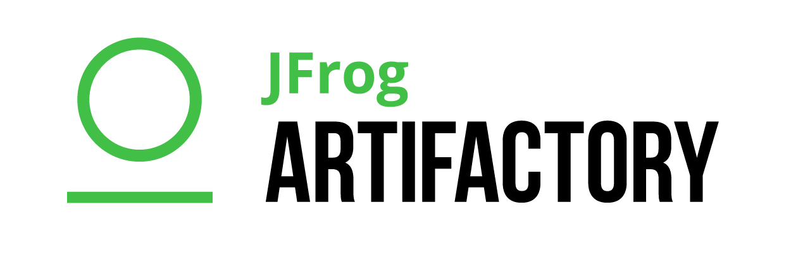






Open Pipeline build scenario – Why Git ? Edit & check-in → Pipeline → Build → Publish → Deploy & Test
1
2
3
4
5
IDE
Pipeline
Orchestrator
Artifact Repository
Deployment Manager
IDzEE
Jenkins Server
JFrog Artifactory
(OSS)
UCD Server
Editors
SCM
Build
Central” git Repository
DBB Server
E-Git Plugin
DBB User Build
Deployment Automation
CPY-1
Build Machine
Unix System Services
MVS
*bins
UCD Agent
PGM-A
CPY-2
Jenkins Agent ‘Task’
git cmdline
File System (PDS)
*metadata
Build Scripts (Groovy)
DBB Toolkit API
RSE
Notes:
Blue highlights the components on Z/OS

Slide 4
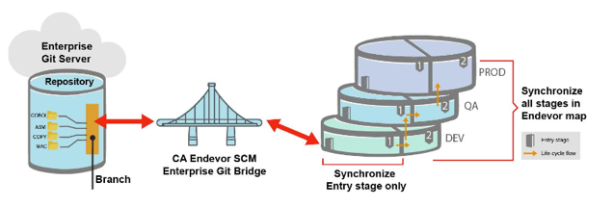
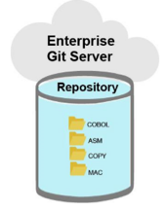
Competitive Landscape : Endevor Bridge
Fonction 1
Fonction 2
Fonction 3
Fonction 4
Here is how the library manager providers recommend that you organize your GIT repositories.
Here is how IBM recommend that you organize your GIT repositories.
From CA Whitepaper :
A Git repository is associated to a CA Endevor SCM System or Sub-system
A Git branch is associated to a CA Endevor SCM Entry stage
The synchronization happens between the Git branch and the selected CA Endevor SCM Entry stage
There are two synchronization options:
– Synchronize all stages in CA Endevor SCM map
– Synchronize only the Entry stage
By organizing it according to the component technology.
It is not their problem if you have trouble finding the elements that make up a function.
It is the way to determine how build the component.
By organizing it according to a functional point of view.
identifying the elements to evolve becomes easy and maintenance is more efficient.
It is not the tool that should influence the evolution of practices but the opposite. A mapping table and an intelligent build tool must be able to dynamically manage the build topology.
Keep in mind : the C of SCM is for Configuration, not Code !

Slide 5
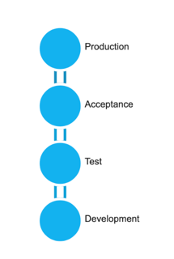
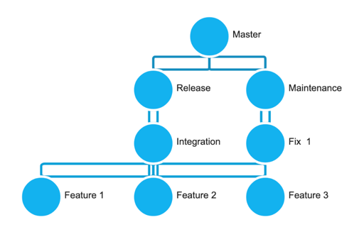
Stages representing test environments compared to isolated configurations for a development task

Slide 6
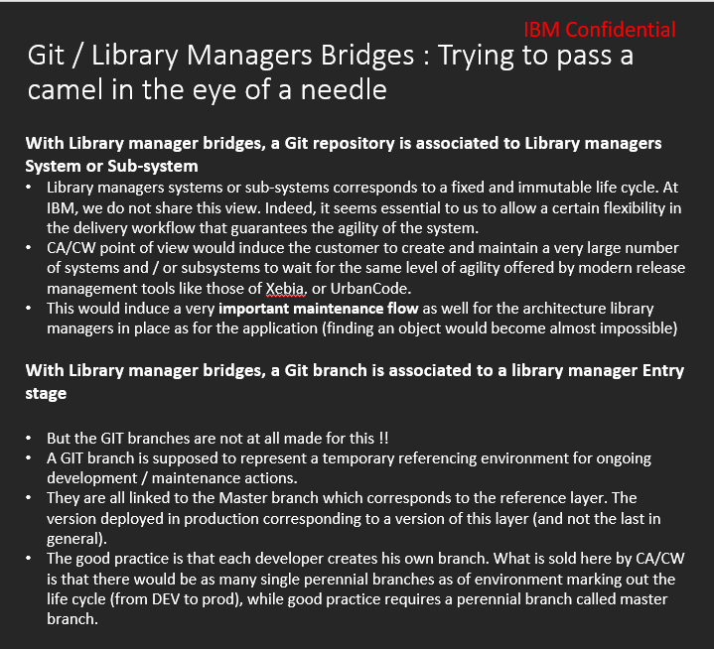

Slide 7





Migration process and tools
Questionnaire
BP/Client Tools
CI/CD Pipeline
SCLM Mig Toolkit
Import Tool
JCL Mig Tool
Application discovery (ADDI)
Analysis Tools
Extraction Tools
Scanner Tools
CI/CD
Migration Tools
Analyse
Extract
Componentize
CI/CD
Migrate
Analysis
Analyse the development process, Infrastructure and document the current state
Extract Metadata, Source Libraries, Compile Procedures and options, Languages, File types from Host SCM
Identify Interfaces and dependencies between applications and componentize
Derive future state architecture
Establish CI/CD workflow
Product deployment
Setup repos and Import
Setup the scripts and establish the pipeline
Notes:
When we reach the migration and deployment steps, here is a list of assets that can be used of assets that can help to scope the effort and support the necessary reorganization work that has been illustrated in the demo. Ready to use CI/CD processes are also part of these, as well as library managers specific migration toolkits.

Slide 8
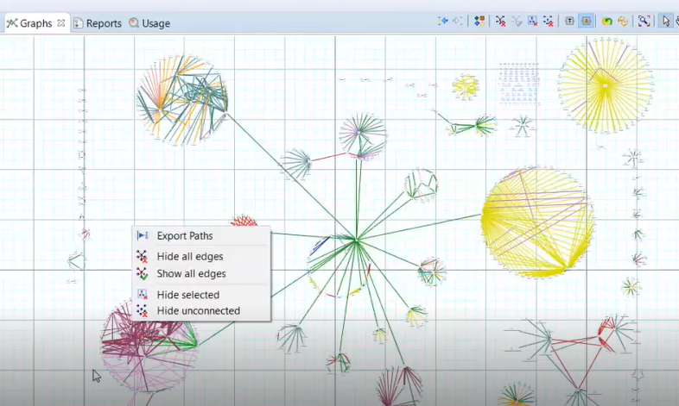
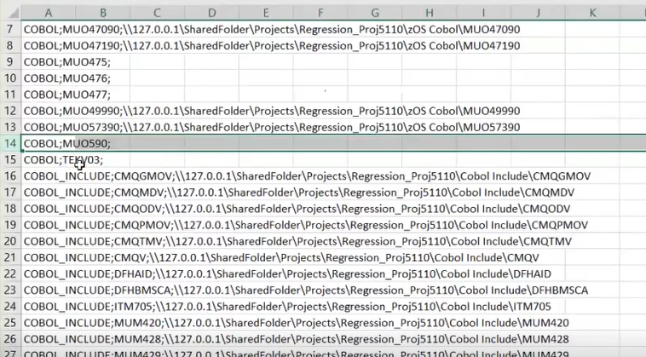
AD for Componentization
Notes:
When we reach the migration and deployment steps, here is a list of assets that can be used of assets that can help to scope the effort and support the necessary reorganization work that has been illustrated in the demo. Ready to use CI/CD processes are also part of these, as well as library managers specific migration toolkits.

Slide 9
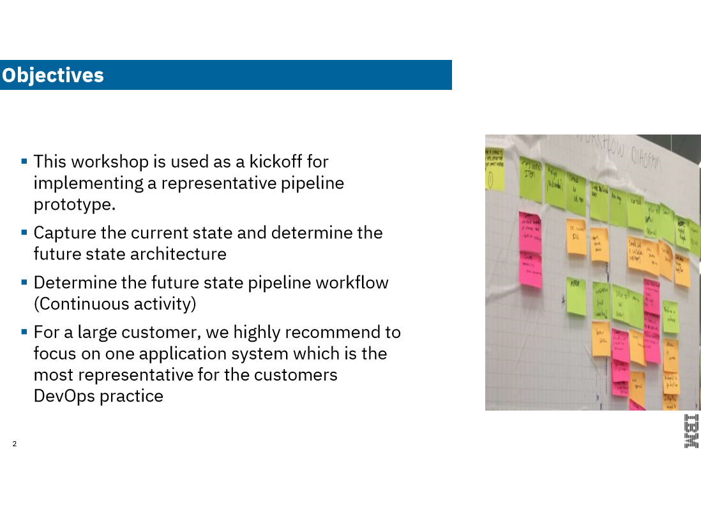
Discovery and Design Workshop
Discovery and Design Workshop
Notes:
When we reach the migration and deployment steps, here is a list of assets that can be used of assets that can help to scope the effort and support the necessary reorganization work that has been illustrated in the demo. Ready to use CI/CD processes are also part of these, as well as library managers specific migration toolkits.

Slide 10
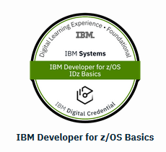
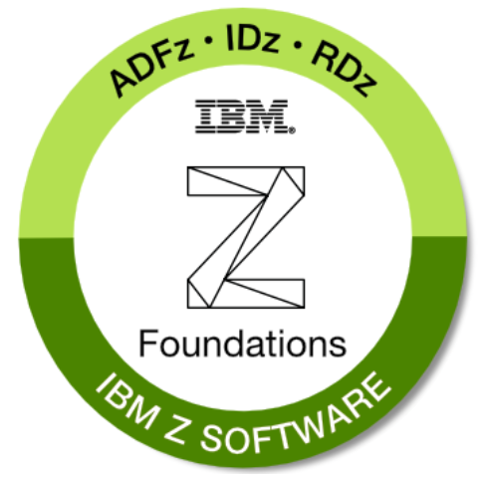
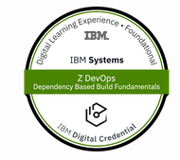
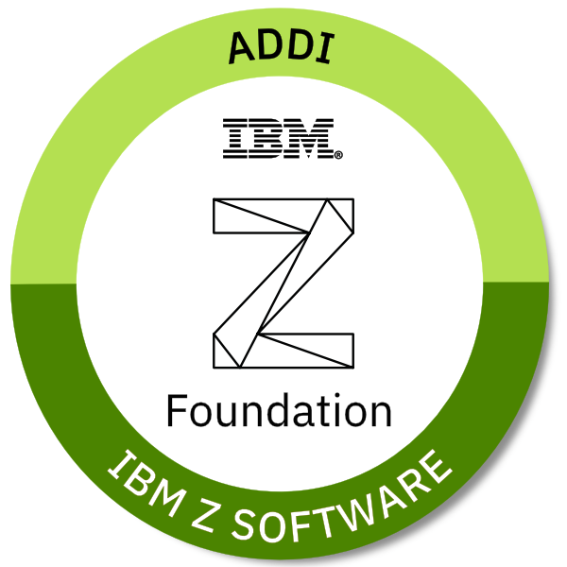
Z Devops Transformation – Trainings to get started
IBM Developer for Z – Instructor Led virtual remote sessions IBM Developer for Z – Self paced online
Mainframe build in a DevOps pipeline with IBM Dependency Based Build
IBM Z ADDI Foundations
https://developer.ibm.com/mainframe/products/devops-acceleration program/training/

Slide 11
Z Devops Transformation – Migration reference and papers
Getting started with DBB
This guide contains the essentials steps to migrate a sample application from z/OS to Git and perform a DBB build using IDz and Jenkins as a Proof-of-Concept (POC
Whitepapers
Develop Mainframe Software with Opensource Source Code Managers and IBM Dependency Based Build
This paper provides guidance how the principles of mainframe software development can be taken into account by a modern SCMs like git, benefit from isolation techniques like branching and integrate development activities within and across teams through merge and consolidation workflows.
Packaging and Deployment Strategies in an Open and Modern CI/CD Pipeline focusing on Mainframe Software Development
Here we’ll discuss the importance of decoupling as a way to foster Continuous Integration and Continuous Deployment practices, by introducing application component repositories, adoption processes, decoupling build, packaging and deployment from each other and work with an artefact repository.
https://developer.ibm.com/mainframe/products/devops-acceleration-program/resources/

Slide 12
Devops Transformation – Migration Tools
1) Partner Tools
Our business partner RRMAC has developed various automation tools and utilities to help automate the migration from a library manager to Git on Z. All tools are licensed and clients can directly buy it from RRMAC
Analysis
Crosswire
LANGCHK
Programming
Language Determination Tool
Source to Load Check
Migration Utilities
2) IBM SCLM to DBB-Git Migration Tool 3) JCL Migration tool
https://developer.ibm.com/mainframe/products/devops-acceleration-program/adoption/partner-tools/

Slide 13


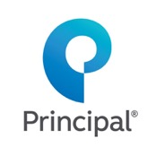

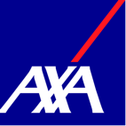










DevOps Acceleration Program
IBM Confidential
2019
20 Plus engagements
100% POC success rate
7 Pilot Migration in progress
“Enterprise Wide Standardization”

Slide 14
DevOps transformation journey with IBM’s DevOps Acceleration Program https://developer.ibm.com/mainframe/products/devops-acceleration-program/
Training
Adoption
Discovery and Design Workshop
SCM Migration
CI/CD
DevOps adoption
Assessment
Deployment
Maximize the value of transformation efforts
Know our DevOps Products and strategy
Instructor Led remote and Self Paced trainings
Install and customize products
Cloud entry point
emphasis to-date
Value Stream Assessment
Innovate
Adoption
Training
Deployment
Build new
cloud native applications
Delivered through
DevOps Acceleration Team
DAT - SCM Migration, CI/CD, DevOps adoption
Executed by IBM’s Sales SWAT team
Onsite Workshop to capture current state and create a transformation roadmap
ILT Virtual or Self paced trainings
Delivered through Deployment Project Office DPO - Remote assistance for upto 52 hours to install products
This is IBM’s Initiative to partner with you and accelerate the transformation
Notes:
Value Stream Assessment – Executed by SWAT team, offering DevOps VSA Engagement, CI/CD Pipeline Mapping, POV Presentations
Training – Covering Idz, ADDI and CI/CD, it is delivering through Z DevOps Learning team as both instructor led Virtual training and online Self paced training
Deployment – Delivered through Deployment project office , offers upto 52 hours of remote assistance to help deploy IDz and ADDI as per best practices
Adoption – Delivered through DevOps Acceleration Team, the team will start with capturing your current state and based on requirements design your future state. Help with preparing scripts and deploy the future state solution and CI/CD workflow.

Slide 15
Componentization is a design workshop activity to define optimal Git repo structure(s).
Discovery & Design
Remote or Onsite discovery and design workshop
Identify current state setup
Determine future state architecture
Migration
Any SCM to DBB-Git
Complete assistance from creating your implementation plan, scripts etc.
Train
Deployment
Know our DevOps strategy and Products
Install and customize products
Cloud entry point
emphasis to-date
Train
Discovery & Design
Migration
Migrate
Innovate
Deployment
Lift & shift applications and workloads
SCM Migration – Onsite and remote support
ILT Virtual or Self paced trainings
Build new
cloud native applications
Remote assistance
Remote or onsite workshop

Slide 16
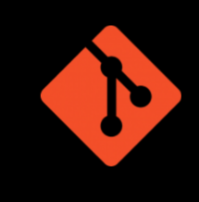
Repo Design Challenges
Reality
Large Monolithic application designs
Sharing code (copybook)
Applications are not well documented
Some code has not been compiled in decades
This makes designing repos hard!
Notes:
Recall this topic from session 1 – on some challenges when designing repos?

Slide 17
What is a “large monolithic application”
A mainframe design pattern where many smaller programs are interrelated as one large Business Application.
For example …

Slide 18
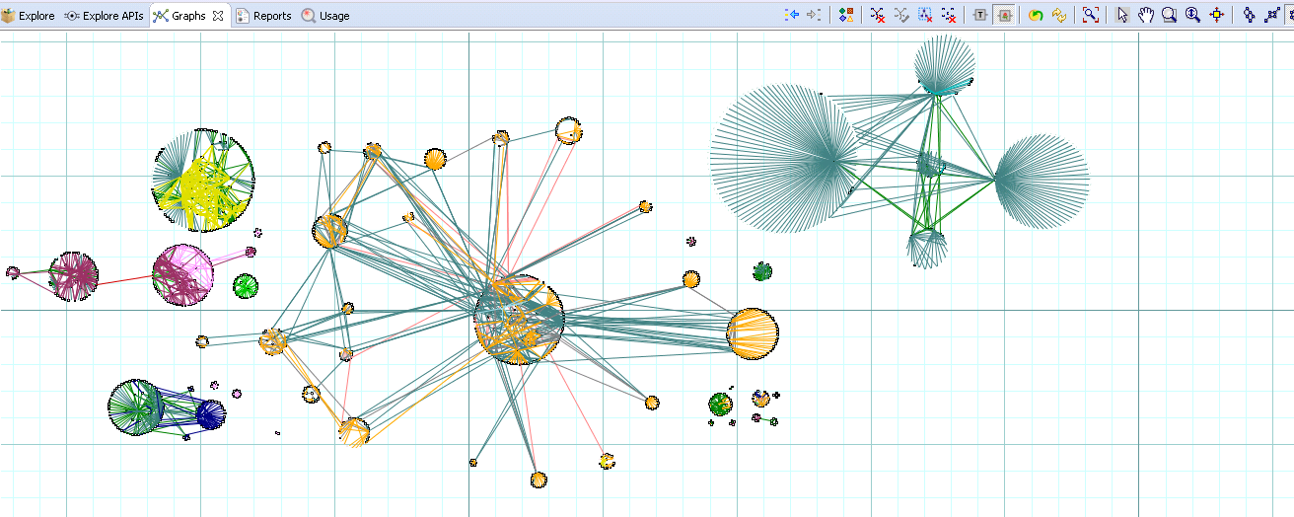
An ADDI map of large applications and their interrelationships

Slide 19
The goal of Componentization is to break up large applications into smaller, manageable repo’s
Application 1
Public Interfaces of Application 1
The source code of the entire IT landscape should be stored in several Git repositories, rather than just one.
The scope of the git repository varies but let's consider that each application has its own repository. We’ll call it an application component.
While identifying their scope might not be obvious, you will encounter components on the mainframe as you would elsewhere. As an example, you can identify the elements which are used solely within a component. Very often the component provides some well-defined interfaces (in COBOL, they are expressed by copybooks). The component itself, can again consume copybooks (aka interfaces) of other components.
Private Implementation of Application 1
Cross cutting interfaces
Application 2
Application 3
Public Interfaces of Application 2
Public Interfaces of Application 3
Private Implementation of Application 2
Private Implementation of Application 3
Interfaces of Application 1
Interfaces of Application 3
Interfaces of Application 1
Cross cutting interfaces
Cross cutting interfaces
Dashed lines represent references to shared interfaces of other application modules or cross cutting interfaces

Slide 20
An example of multiple small repos for a large Monolithic application
You can manage several Eclipse projects within the repository, representing a functional component of your application system.
Remember: The Eclipse project is the smallest entity which you load into your IDZ workspace.
Each project, will have several subfolder, in most cases represent the different types of your application, which can be used for the Mapping to the language scripts.
/BOOKING-TAXES
|_ COPYBOOK
|_ COPY01.cpy
|_ COPYBOOK_PUBLIC
|_ COPY02.cpy
|_ COBOL_PROGRAMS
|_ LO28050.cbl
|_ ASM_PROGRAMS
|_ AM28050.asm
/BOOKING-TAXES-FOREIGN
….

Slide 21
The approach to manageable Git repositories and addressing developer needs
Step 1: Define which files made up your application.
This is a manual process
Step 2: When the application is defined, we need to identify internal and external elements
Identify interfaces / shared items across application scopes
However, we might still end up with files with a lot of references within the same project
IBM Application Discovery can support defining your application.
Typically customers know this already based on a data dictionary

Slide 22
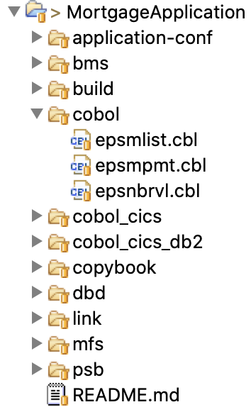
Once componentized we can migrate a Customer’s application to Git
Defining application components
Prepare a Git Folder structures
Setup Migration Mapping
Migrate from PDS to USS
Push from USS to git
> migrate.sh
-r /u/dbehm/migration-repository/dbb-test-repo
/u/dbehm/migration/mappingfile-mortgage.txt
Local GIT repository: /u/dbehm/migration-repository/dbb-test-repo
Migrate data sets using mapping file /u/dbehm/migration/mappingfile-mortgage.txt
Copying [DBEHM.DEMO.COBOL, EPSMLIST] to /u/dbehm/migration-repository/dbb-test-repo/cobol/epsmlist.cbl. Using default encoding
Copying [DBEHM.DEMO.COBOL, EPSMPMT] to /u/dbehm/migration-repository/dbb-test-repo/cobol/epsmpmt.cbl. Using default encoding
Copying [DBEHM.DEMO.COBOL, EPSNBRVL] to /u/dbehm/migration-repository/dbb-test-repo/cobol/epsnbrvl.cbl. Using default encoding

Slide 23
Packaging and Deployment Strategies
What is Packaging and Deployment?
Why an Artifact repository matters?
UrbanCode Deploy New & Noteworthy
Notes:
Intro the topic

Slide 24




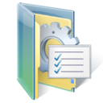

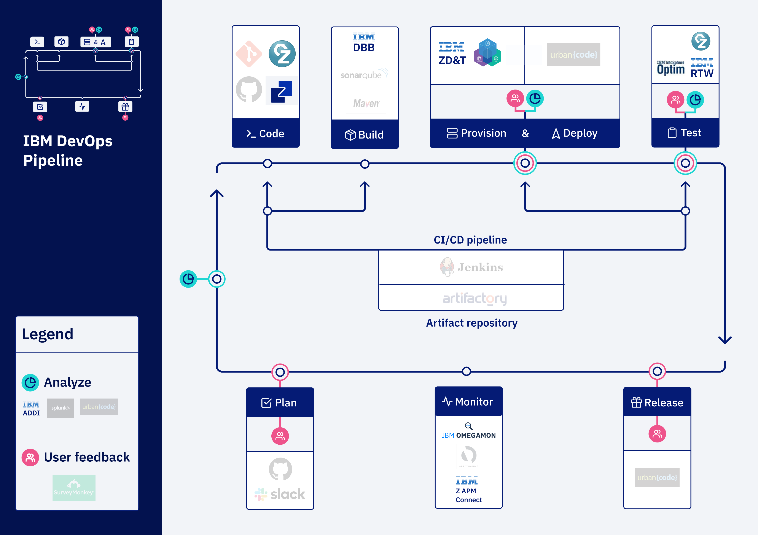
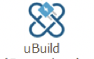

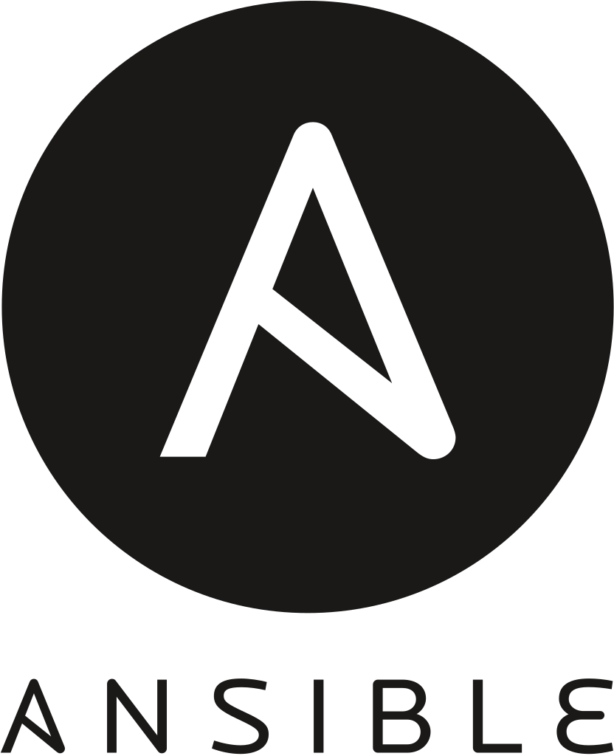










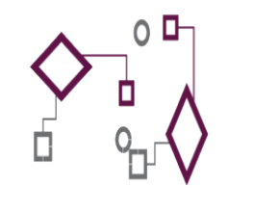











EL
Code
IBM Dependency Based Build (Git)
Provision & Deploy
EL
Test
IBM Developer for Z
EL
Build
Z Open Development
IBM Z Development and Test Environment
Z Open Unit Test
RTW
PACKAGE
DEPLOY
EL
Analyze
IBM Application
Discovery and Delivery Intelligence
CI/CD pipeline
Integrated Pipeline Example
Plan
Monitor
Release
LEGEND
IBM Z APM Connect
OMEGAMON
Operational Insights
Analyze
Feedback,
approvals

Slide 25
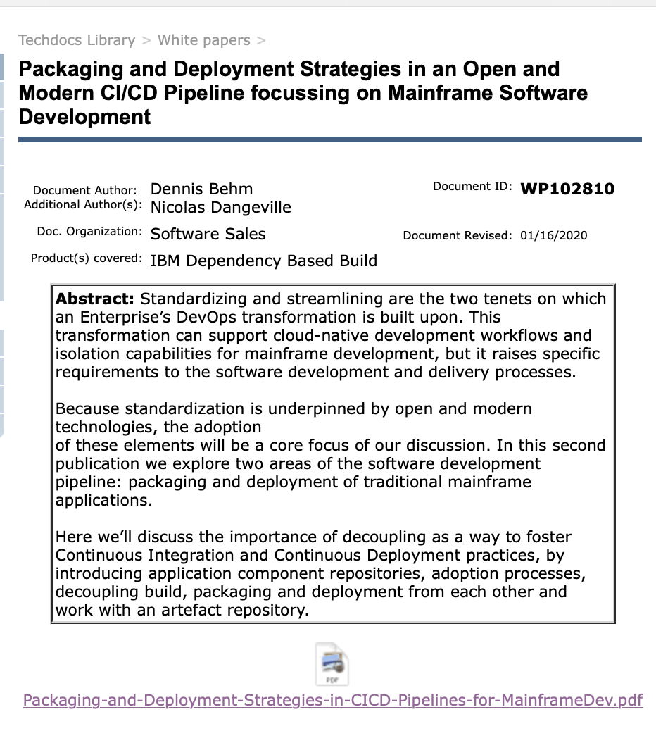
White paper
Packaging and Deployment Strategies in an Open and Modern CI/CD Pipeline focussing on Mainframe Software Development
https://www-03.ibm.com/support/techdocs/atsmastr.nsf/WebIndex/WP102810

Slide 26
What is a package?
A deployable file (tar) containing
Application build outputs like binaries and DBRMs (yellow)
Application’s configuration items like Database and CICS definitions (blue)
automatically created in a Pipeline at the end of a DBB Build
LOAD modules
DBRM
Jobs
Control Cards
JAVA
CICS / IMS definitions
MQ Definitions
DB2 Schema
Server Configuration
Test cases and Test Data
Notes:
Show sample in Artifactory – DAT Tass Srvr You consider build outputs (items highlighted in yellow) as part of your package. But it’s equally important that we consider the application specific configuration artifacts (items highlighted in blue). Doing so will help teams avoid a flood of change requests, limit constant back and forth communication, and will enable the continued use of deployment automation.
Application specific configurations need to be treated as source code, the same way you manage your application source code.
Not everything needs to end up in a single package, we can also think of configuration and application packages.
You consider build outputs (items highlighted in yellow) as part of your package. But it’s equally important that we consider the application specific configuration artifacts (items highlighted in blue). Doing so will help teams avoid a flood of change requests, limit constant back and forth communication, and will enable the continued use of deployment automation.
Application specific configurations need to be treated as source code, the same way you manage your application source code.
Not everything needs to end up in a single package, we can also think of configuration and application packages.

Slide 27

Packages are stored in Artifact Repositories like Jfrog’s Artifactory or as Components in UCD’s CodeStation
Artifact repositories focus on storing and versioning the build results along with their metadata and necessary information to trace back to the change(s) in the version control system.
The artifact repository contains a complete history of packages, and therefore also provides access to older versions for example for rollback.
It is expected to be the single point of truth for binaries.
It acts like a proxy for the deployment manager to deploy the artifacts to the runtime environments.
It is a key element to implement the CI/CD pipeline and decouples version control systems from the actual execution environments
Today, popular artifact repositories include products such as JFrog Artifactory or Nexus.
Artifact Repository
JFrog Artifactory
Sonartype Nexus
Deploy Codestation
Notes:
Next slide focuses on decoupling

Slide 28
Why is decoupling Important?
Traditionally source and runtime artifacts (load modules) where packaged and deployed together for lots of reasons
The goal of a sound DevOps solution is to split (decouple) Source and runtime
To simplify and exploit deployment across a wider range of runtimes (Real or virtual host) that are on-perm or in the cloud.
Convincing clients that decoupling is good may be a challenge (change can be hard for some)

Slide 29






Modern Z Development
Analysis & Planning
Development Phase
Continuous Deployment
Developers
Sprints
zD&T
CI - User Builds
Ops
. Automated Impact Analysis
. Code Checkout & packaging
. Automated Test environment buildout
Branch
Code
Commit
IDz
Unit Test
Report
Build
QA …
PROD
Distributed SCM
Git
Dev Repo
Clones
Git Hub
Feature #52
Pull Requests
DBB
Groovy
zUnit
Urban Code
A modern DevOps workflow is founded on sound Agile practices and leverages tools and skills to streamline all phases of the process. It fosters a culture of cooperation and efficiency across all levels of support – Business Partners, Developers, QA, Release Engineers and Operations.
Feature #12
zD&T
CI - Team Build
SIT
Report
Build
Team
Repo
Admin
Lead
Code Review
Merge
Commit
release
Artifact
Deploy
Jenkins
DBB
Groovy
zUnit

Slide 30
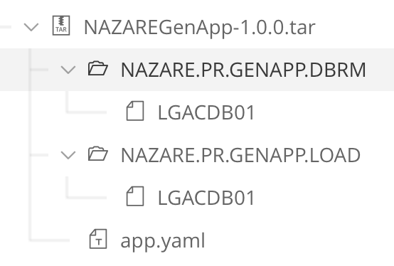
Package Content, Layout and the Manifest
The package is represented in an archive format like a tar.
Distributed applications are usually working with full application packages, such as a WAR or a JAR.
The package contains
the actual binaries and files produced by the build manager
a manifest describing its contents (which is metadata)
In a mainframe context, your package will contain executables required to run your application like load modules, dbrms, jcl, control cards, but it can also carry listings or debug files, which you use when analyzing a bug.
Application
binaries
Manifest file containing additional metadata
Notes:
Click on image for Live view (must have authority to view) @https://eu.artifactory.swg-devops.com/artifactory/webapp/#/artifacts/browse/tree/General/sys-nazare-sysadmin-generic-local/genapp/1.0.0/PR-269/1

Slide 31
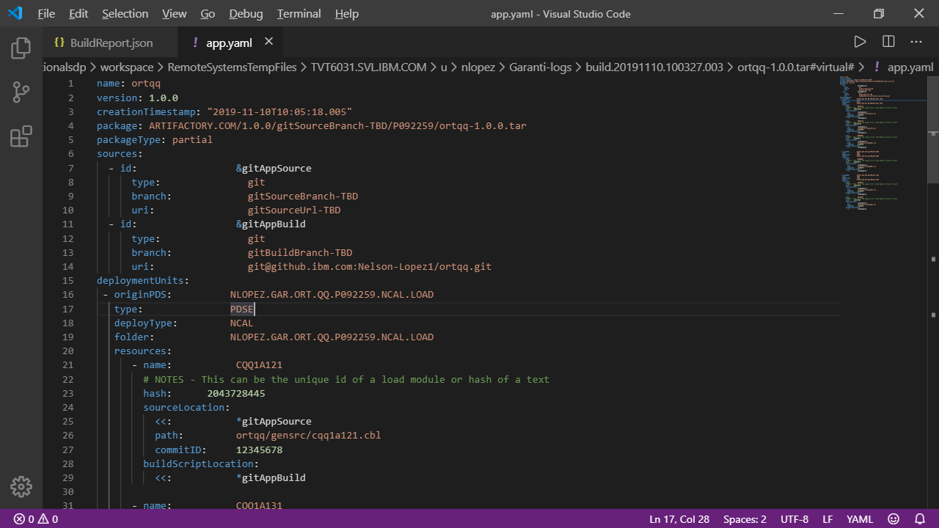
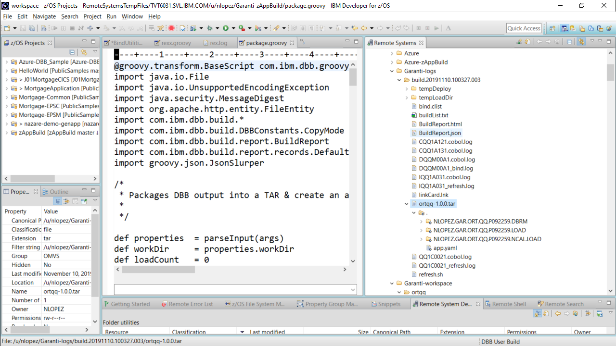
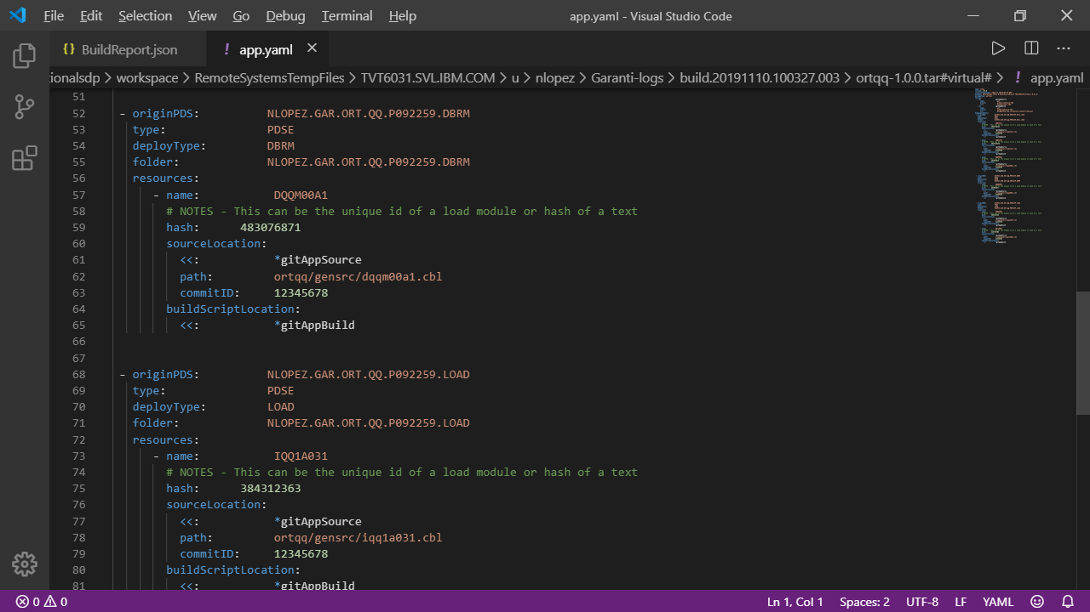
PublishLoadModules.groovy - creates package and manifest
Reads json report and tar’s all build artifacts
Creates app.yml file
BuildReport.json
TARFILE
Artifacts
artifact
artifact
artifact
App.yaml
artifact
artifact
https://github.com/IBM/dbb
Notes:
Click on link to a walkthru

Slide 32
Manifests help drive the Deployment process
Due to the nature of mainframe deployments, we need to capture additional metadata, like the type of the object, for each binary in the package.
So there is a need for a manifest file describing the contents of the application package, which will also be used by the deployment manager.
Additionally, it is recommended to capture information about the configuration the package was created of – so a git hash to trace back to the actual version of the source code. And also capture the packageType – full or incremental
<Package Name>
|_build reference
|_packageType (full, incremental)
|_git-hash (the state of the branch)
|_contents
| Container PGM TYPE PARMS
CICD.APP.FEAT1.LOAD PGM001 BATCH_DB2
CICD.APP.FEAT1.LOAD PGM002 BATCH_DB2
CICD.APP.FEAT1.LOAD PGM003 BATCH
CICD.APP.FEAT1.LOAD PGM004 BATCH
CICD.APP.FEAT1.LOAD PGM005 CICS
CICD.APP.FEAT1.LOAD PGM006 CICS_DB2
CICD.APP.FEAT1.LOAD PGM100 BATCH
CICD.APP.FEAT1.DBRM PGM001 DBRM
CICD.APP.FEAT1.DBRM PGM002 DBRM
CICD.APP.FEAT1.DBRM PGM006 DBRM
Schema of an Application Package Manifest

Slide 33
Nexus/Artifactory Support with new package format
z/OS LPAR, Build system
Nexus /
Artifactory
z/OS LPAR
Build System
Agent
PDS
Sequential
HFS
Create Package
Download artifacts
deploy
Deploy data sets
CICS
DB2
WASz
MQz
IMS
Create new version
CodeStation
In UCD
Store version artifacts
z/OS DeployToolkit
Store meta data
More Middleware Deploy steps
Server
Package Individual Artifacts “as is”
JCL
REXX
TSO
ISPF
MVS
SHELL
More z/OS
Deploy steps
Update Inventory status
Note: LPARs can be the same or different LPARs
Notes:
(Nlopez Note) Not sure what New package format is?

Slide 34
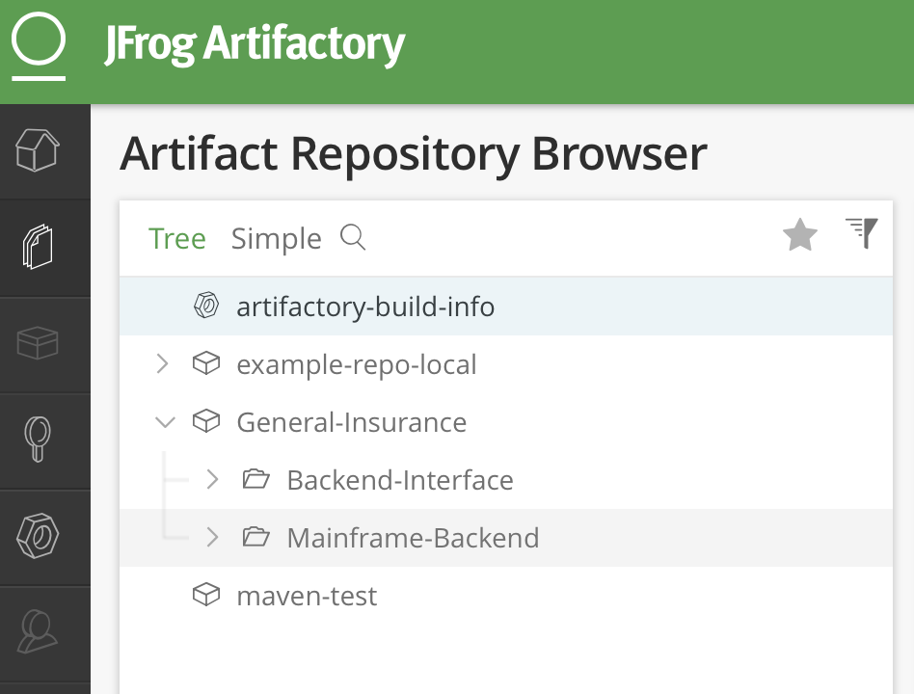
The artifact repository consolidates application components
Assuming an application consisting of several application components like a frontend, middle tier and backend, we will see one artifact repository entry for the whole application with subfolders for each application module.
This also leads to mainframe build outputs like load modules being transferred to the central artifact repository manager.

Slide 35
The package scope
We need to distinguish between a full package – all executables belonging to an application module – and partial packages.
Partial packages can be divided into two types: delta packages - which are produced immediately after each build and cumulative packages – those that include outputs produced by several builds.
Mainframe applications typically work with incremental updates of the execution environment.

Slide 36
What’s new with packaging and deployment on IBM Z
Enhance support that allows packages to move from mainframe libraries into distributed Artifact repositories with loss alias names.
PTF OA55299 (Closed June-2018) : NEW FUNCTION - ENHANCE CP TO SUPPORT COPY FILES TOGETHER WITH ALIAS. https://www-01.ibm.com/support/docview.wss?crawler=1&uid=isg1OA55299
Notes:
A fix is available
Obtain the fix for this APAR.
APAR status
Closed as new function.
Error description
WHEN CLIENTS COPY FILES WITH ALIAS FROM MVS TO USS, AND THEN COPY BACK FROM USS TO MVS, THE ALIAS RELATED TO FILES WILL BE LOST.
After this PTF is applied, the cp shell command with the -I option will specify that alias information is to be copied when the file is copied from z/OS UNIX to MVS.

Slide 37
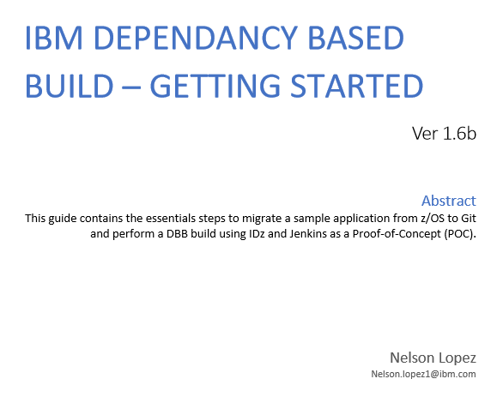
Conclusion – What We Covered (session 1 & 2)
How to design GIT repos to store source code and migrate customers applications
How Git actions like commit or Pull Request trigger a Pipeline to automatically Build, package, Test and Deploy
Most importantly - You now have a better understanding of the tools and technology to have more meaningful client engagements
IDE
Pipeline Orchestration
Deployment
Manager
SCM
Build
Artifact Repository
Notes:
Getting started

Slide 38
Thank You

